Slide 1

Mobile Architecture
Otniel Yosi Viktorisa
Product Developer Team Lead at PT. Altrovis Tekno Global
otniel.y.viktorisa@gmail.com

Slide 2
What is architecture
the patterns and techniques used to design and build an application
a set of structural elements along with their interfaces that compose the system
a starting point or roadmap for building an application

Slide 3
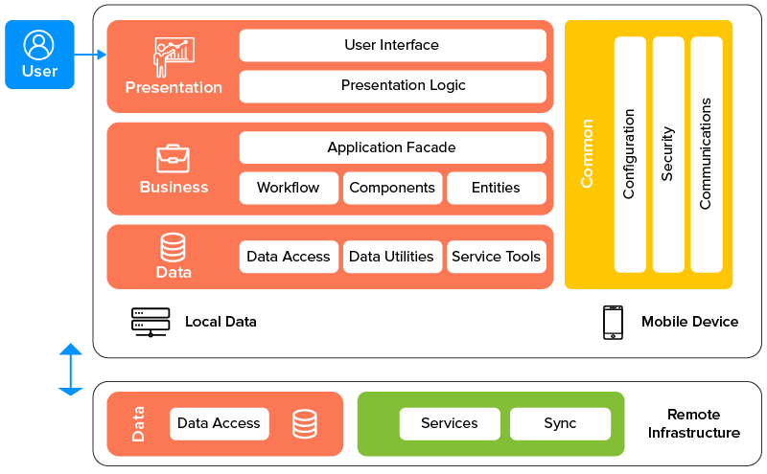
Layered architecture
Image:https://os-system.com/blog/mobile-app-architecture-how-to-design-it/

Slide 4
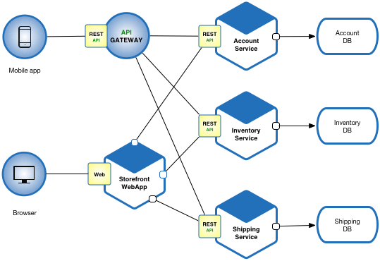
Monolithic vs Microservices
Image:https://microservices.io/

Slide 5
Benefit of Microservices
Enables the continuous delivery and deployment of large, complex applications
Improved maintainability
Better testability
Better deployability
Each team can develop, test, deploy and scale their services independently of all of the other teams
Improved fault isolation
Eliminates long-term commitment to a technology stack

Slide 6
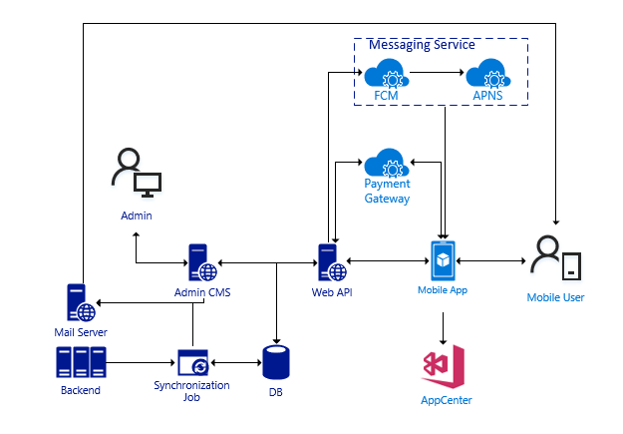
Case study #1

Slide 7
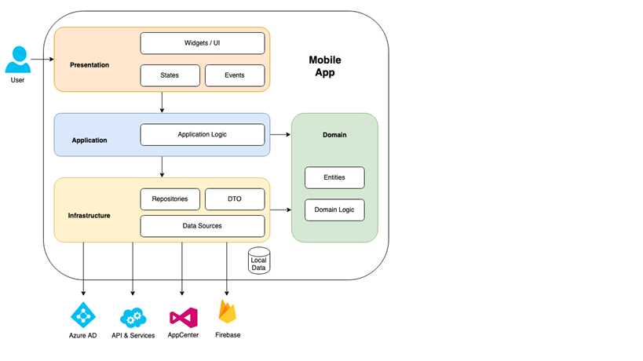
Case Study #2

Slide 8
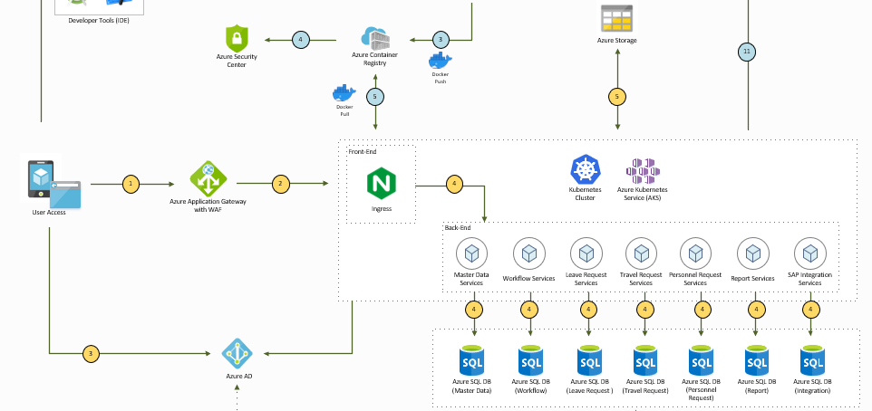
Case Study #2 (cont)

